Slide 1

Forecasting US Clothing
Retail Sales After COVID
Shreya Sinha • Business Forecasting Final Project

Slide 2
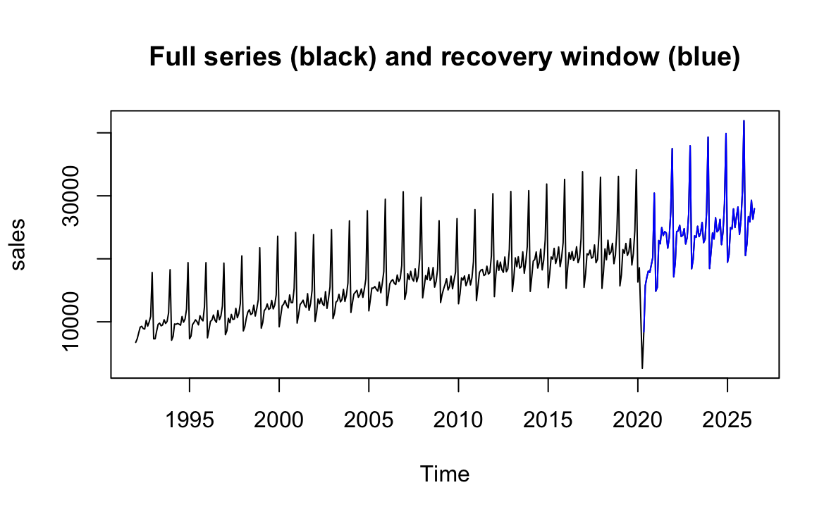
The Problem
What are we forecasting?
  Monthly US retail clothing store sales
  Next 2 years: Aug 2026 to Jul 2028
  Based on data since January 2021
Why is it important?
  Strong yearly cycle makes it a good test of our forecasting methods
  Inventory stocking and staffing are committed months before sales happen, so a forecast helps for effective cost allocation
  Too much stock means markdowns and tied-up cash which puts a strain on profits
  Too little means empty shelves at the busiest time leading to losing customers
  Similar scenarios exist for staffing levels

Slide 3
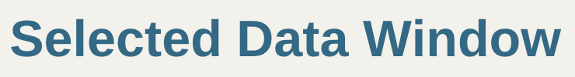
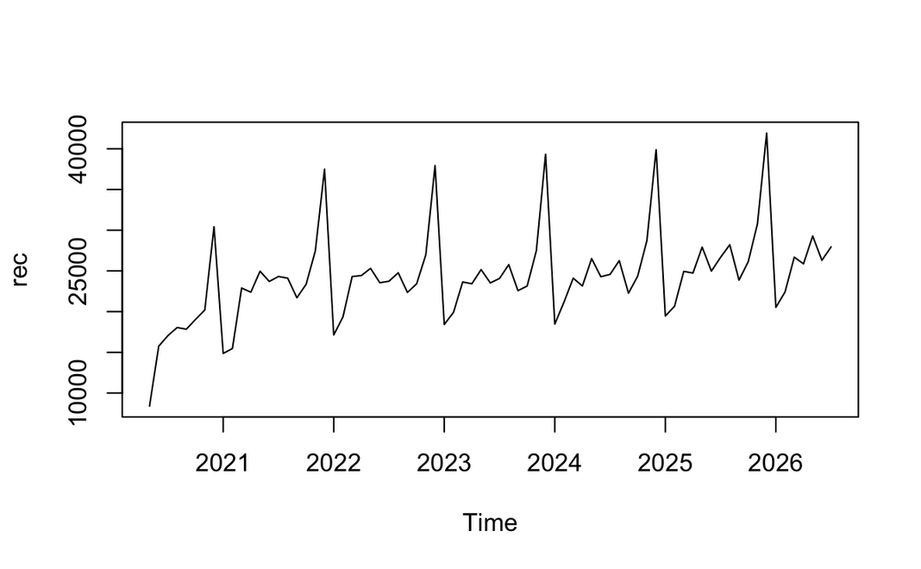
FRED
75 months
reliable source
window
May 2020
Jul 2026
start
end
Why exclude 2020?
To avoid bias from the structural break because of pandemic lockdown. This gives us a more accurate base to forecast from.

Slide 4

Methodology - Models and Accuracy
Mean
Naïve, Seasonal Naive
ARIMA
Constant historical average
Naïve repeats last observation, snaive repeats last seasonality
Uses past values and past residuals
SSE
Holt–Winters
STL forecast
Level only
Level + trend + seasonality
Decomposition + ETS
Accuracy Measure: MAPE
Reasoning: I chose MAPE because it shows the error as a percentage of sales, so it means the same in a smaller month like January as in December, and it’s easy for management to read.

Slide 5
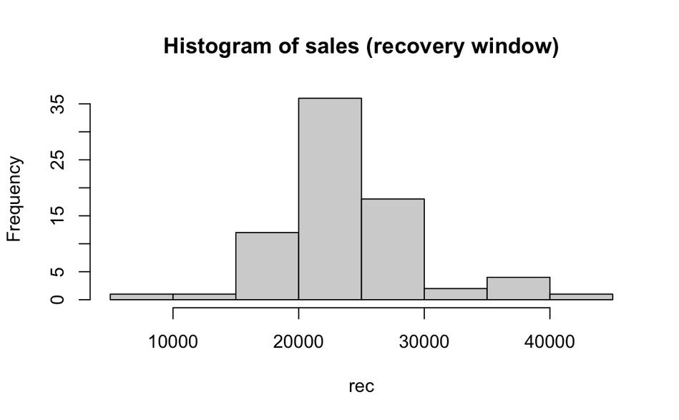
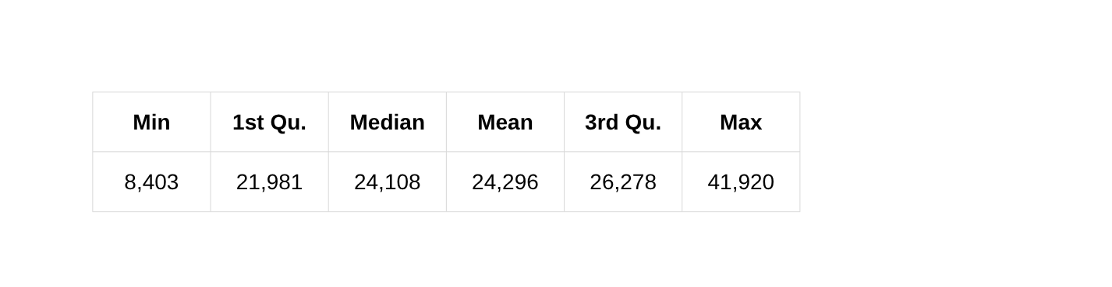
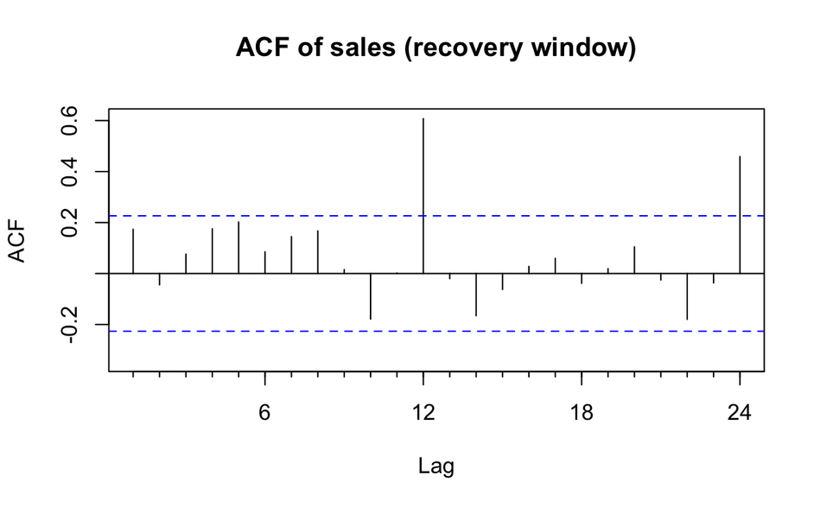
Data Exploration
Summary Statistics
Histogram
  Most of the months’ sales are falling in the 15000 to 30000 range which makes sense with the average
  Bars higher than 30000 most likely are the peaks in December when clothing spending is high due to holidays
ACF
  There are large spikes at lag 12 (~0.6) and lag 24 (~0.4) so we can see yearly pattern, hence seasonality is present
  The other lag bars remain within the blue dotted lines and there's no decay or upward movement seen so trend is not present significantly

Slide 6
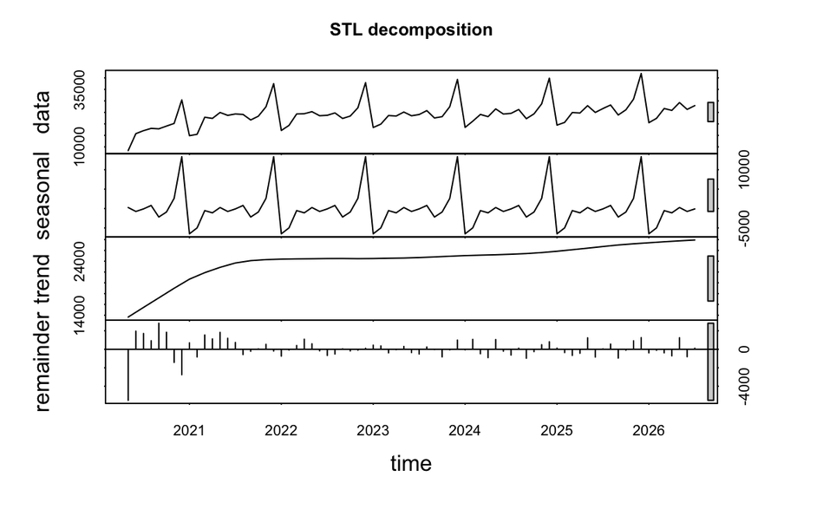
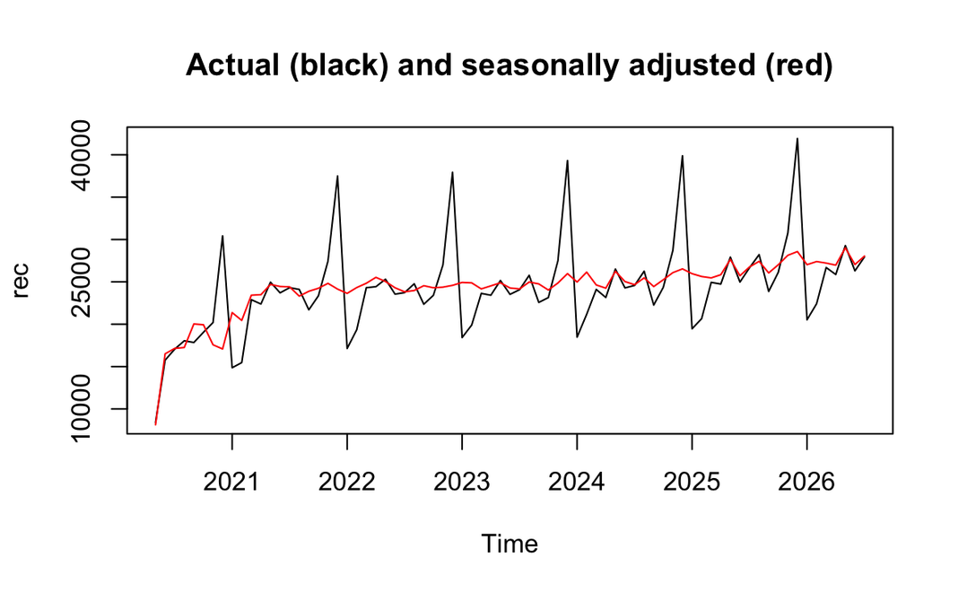
Decomposition and Seasonal Adjustment
Type of Series
  The seasonal swing is also growing with the level of sales, so it is multiplicative since it doesn’t just increase the same amount each year
STL decomposition
  Trend: It rises in 2020 to 2021 as sales recover, then it’s almost flat
  Seasonality: The biggest section, repeating yearly
  Random: This is small, except in the first few recovery months of 2020
Seasonally adjusted
  The red line graph depicts the seasonally adjusted data
  After removing seasonality sales are almost flat after 2021
Seasonal pattern
  Seasonality shows December as the highest month
  January and February are the lowest

Slide 7
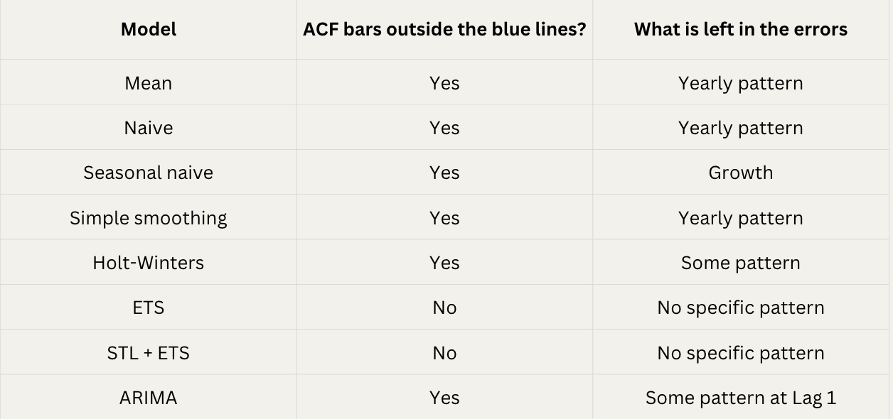
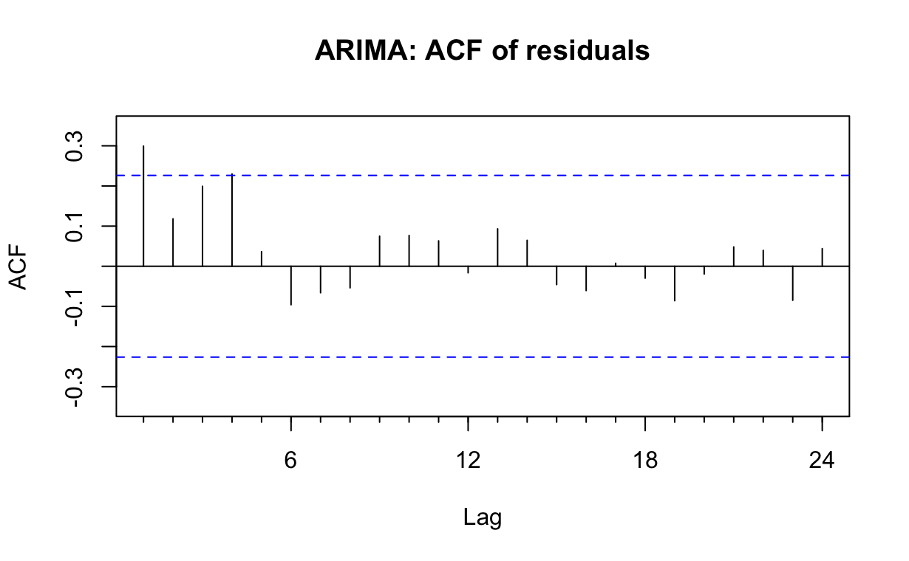
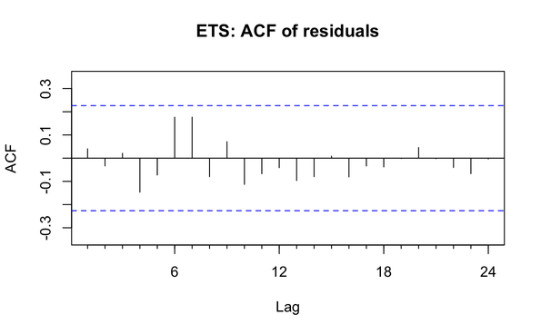
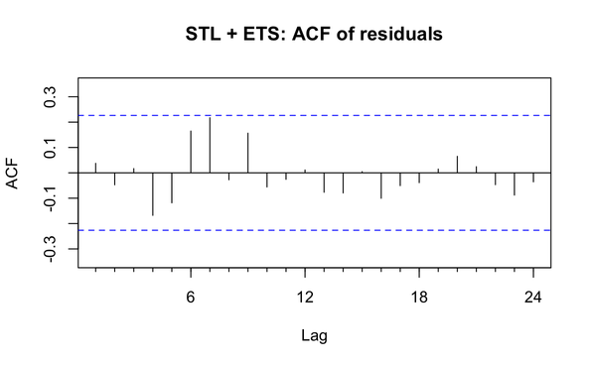
Residual Analysis
Top Performing
  Naive, mean, simple smoothing: The yearly pattern is left in the residuals because these models don’t account for seasonality
  Seasonal naive: The yearly pattern is not there, but growth trend is left in the errors
  Holt-Winters: A small pattern is still left in the errors
  ARIMA: A small autocorrelation remains uncaptured
  ETS and STL + ETS: The residuals look random, so the pattern has been captured by the model

Slide 8
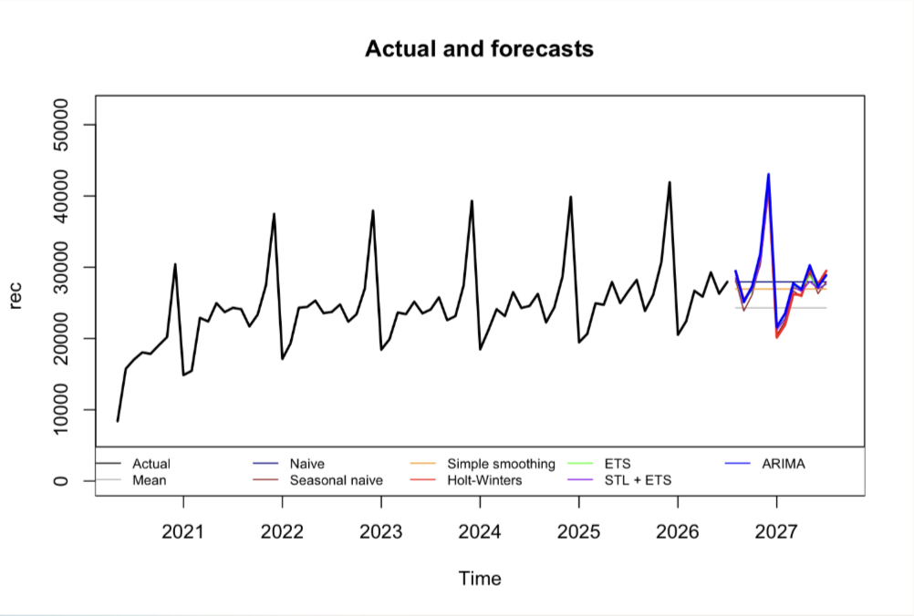
Forecast Inferences
  ARIMA: It captures the recurring seasonal pattern, with sharp December peaks and January drops, while showing a slight upward trend in overall sales
  Holt-Winters: This follows both the level of sales and seasonality; best follows the actual data series
  ETS and STL: Like Holt-Winters, but the slight growth in level is not followed
  Seasonal Naive: It is replicating the seasonality of the previous year, but no growth is captured
  Mean, Naive, & Simple Smoothing: They forecast a flat horizontal line, failing to account for any trend or seasonality

Slide 9
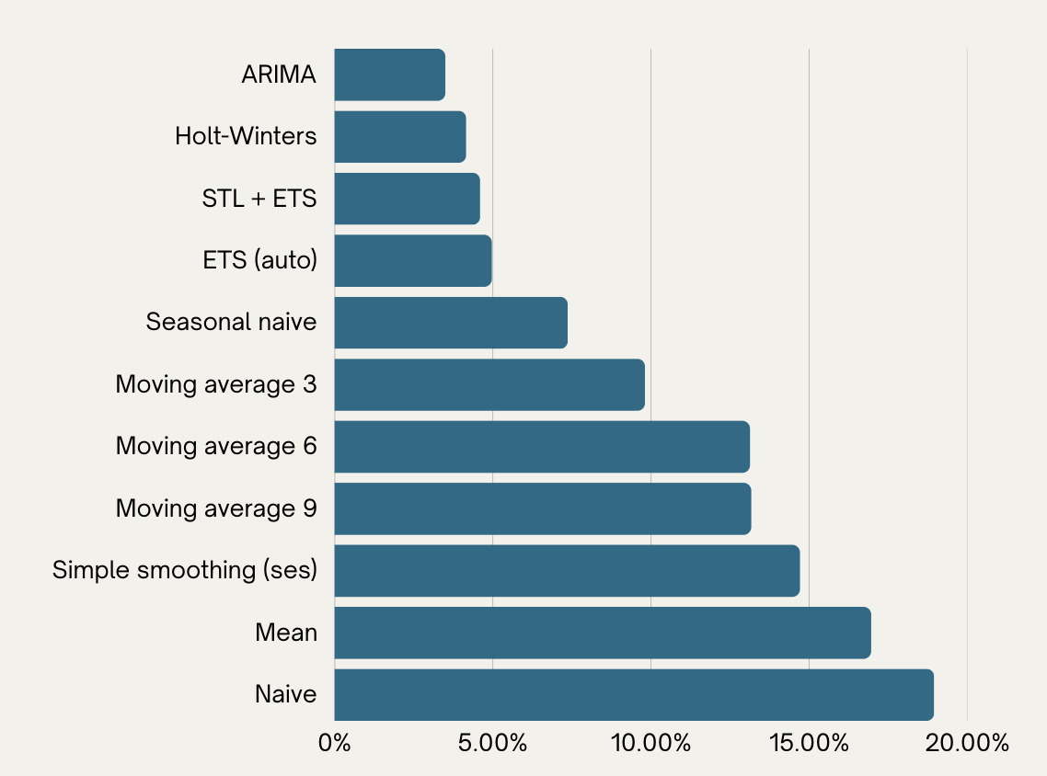
Recommendation
  ARIMA is the best performing model with the lowest MAPE at 3.5%
  Holt-Winters is the second most accurate model with a MAPE of 4.16%
  STL + ETS and ETS are a close third with around 5% MAPE
  The simpler models like Naive, Mean and SS give higher MAPE since they do not account for seasonality and trend
Recommendation: ARIMA

Slide 10
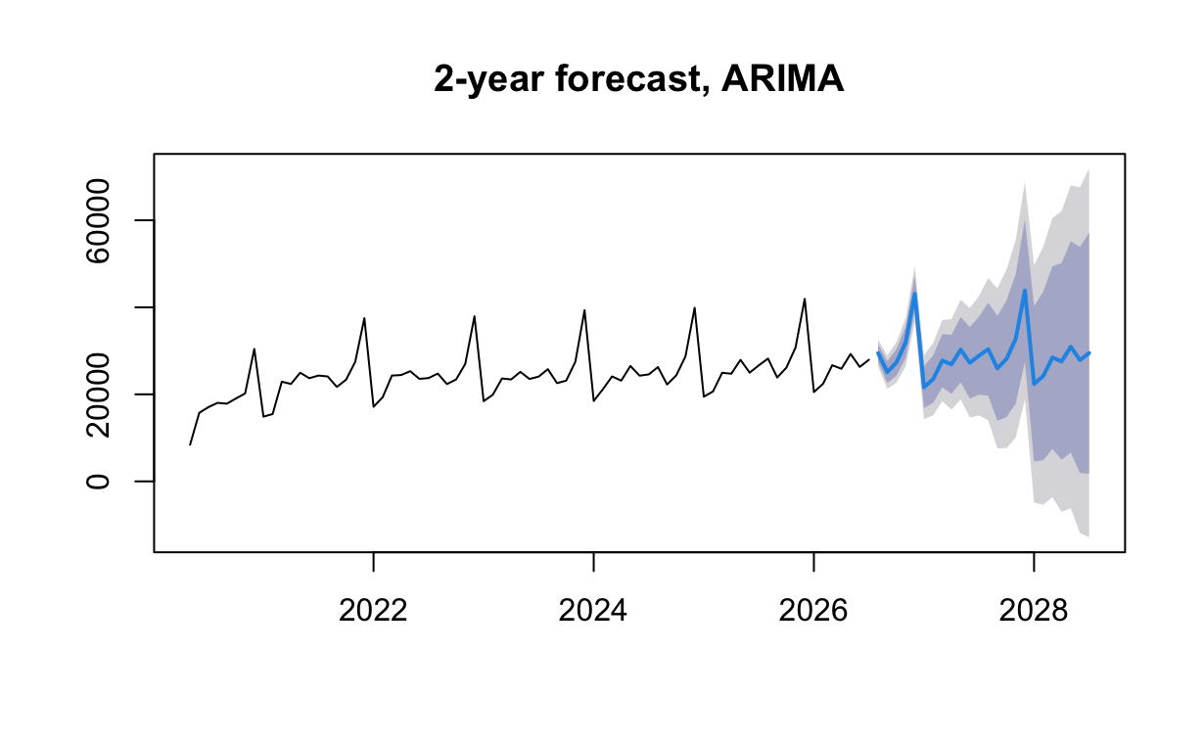
Final Forecast
Inference
The forecast is able to capture the seasonality occurring yearly with peaks in December and drops in January likely due to holiday season spend increase
The model shows a December 2026 peak of approximately 43,100, followed by a sharp drop to around 21,600 in January 2027.
Total forecast sales show a gradual increase, from 2026 to 2027, so there is a small trend upward.
The shaded area is the confidence interval at 80% and 95%, it widens over time because there is less certainty in the forecast as its further in future
Conclusion
Total sales for the next year are forecast at approximately 343,100, showing a 4% increase when compared to previous year
The forecast hence forecasts moderate growth and the peaks and drops during holiday season and after emphasise criticality in stock planning accordingly
The first year (2027) is a more accurate forecast so it can be used for planning while the 2028 forecast should be rerun at a future time
The model should be updated as actual sales data becomes available to improve forecast accuracy.

Slide 11
Improvement Opportunties
Fix the leftover pattern in the errors
02.
04.
Add external factors
Test on data the model hasn’t seen
Combine several models
01.
03.

Slide 12


